Slide 1

Topic 5 – Smart Contract & dApp
Notes:
“Operating Systems: Internal and Design Principles”, 8/e, Global Edition by William Stallings, Chapter 5 “Concurrency: Mutual Exclusion and Synchronization”.

Slide 2

Remix
Go to the latest version at https://remix.ethereum.org/
Notes:
At first glance, it may seem that interleaving and overlapping represent fundamentally different modes of execution and present different problems. In fact, both techniques can be viewed as examples of concurrent processing, and both present the same problems. In the case of a uniprocessor, the problems stem from a basic characteristic of multiprogramming systems: The relative speed of execution of processes cannot be predicted. It depends on the activities of other processes, the way in which the OS handles interrupts, and the scheduling policies of the OS.

Slide 3
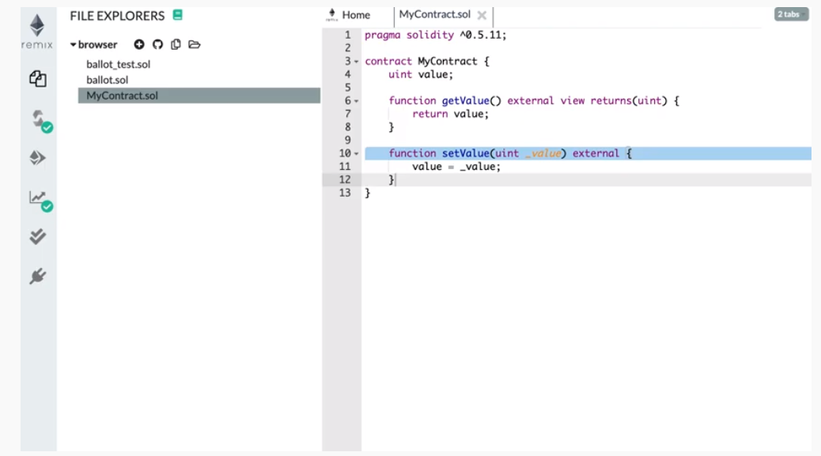

Intro videos on Remix
https://www.youtube.com/watch?v=SeQluFcMPTc
https://www.youtube.com/watch?v=bqyrRS5AN00
Notes:
At first glance, it may seem that interleaving and overlapping represent fundamentally different modes of execution and present different problems. In fact, both techniques can be viewed as examples of concurrent processing, and both present the same problems. In the case of a uniprocessor, the problems stem from a basic characteristic of multiprogramming systems: The relative speed of execution of processes cannot be predicted. It depends on the activities of other processes, the way in which the OS handles interrupts, and the scheduling policies of the OS.

Slide 4
Copy this program into Remix
https://www.youtube.com/watch?v=SeQluFcMPTc
pragma solidity ^0.5.1;
contract HelloWorld {
string private stateVariable = "Assalamualaikum...";
function hi () public view returns (string memory) {
return stateVariable;
}
}
Notes:
At first glance, it may seem that interleaving and overlapping represent fundamentally different modes of execution and present different problems. In fact, both techniques can be viewed as examples of concurrent processing, and both present the same problems. In the case of a uniprocessor, the problems stem from a basic characteristic of multiprogramming systems: The relative speed of execution of processes cannot be predicted. It depends on the activities of other processes, the way in which the OS handles interrupts, and the scheduling policies of the OS.

Slide 5
We do by…
Relying on good tools
But the tools also change fast, but its downward compatible.
Learn by observing others’ programs
Copy&Paste, and make sure they work as intended
This is the culture in github programming
Still, because blockchain is fast evolving:
things keep on changing
Will run into problems, so good to join a community of developers, somebody somewhere will give ideas to solve our problem
Notes:
At first glance, it may seem that interleaving and overlapping represent fundamentally different modes of execution and present different problems. In fact, both techniques can be viewed as examples of concurrent processing, and both present the same problems. In the case of a uniprocessor, the problems stem from a basic characteristic of multiprogramming systems: The relative speed of execution of processes cannot be predicted. It depends on the activities of other processes, the way in which the OS handles interrupts, and the scheduling policies of the OS.

Slide 6
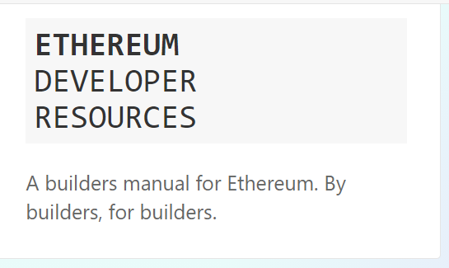

Community of developers…
https://ethereum.org/en/developers/
Notes:
At first glance, it may seem that interleaving and overlapping represent fundamentally different modes of execution and present different problems. In fact, both techniques can be viewed as examples of concurrent processing, and both present the same problems. In the case of a uniprocessor, the problems stem from a basic characteristic of multiprogramming systems: The relative speed of execution of processes cannot be predicted. It depends on the activities of other processes, the way in which the OS handles interrupts, and the scheduling policies of the OS.

Slide 7

Online chat community
Notes:
At first glance, it may seem that interleaving and overlapping represent fundamentally different modes of execution and present different problems. In fact, both techniques can be viewed as examples of concurrent processing, and both present the same problems. In the case of a uniprocessor, the problems stem from a basic characteristic of multiprogramming systems: The relative speed of execution of processes cannot be predicted. It depends on the activities of other processes, the way in which the OS handles interrupts, and the scheduling policies of the OS.

Slide 8

Or grab resources with only the essentials
Suggest to use this simple book which can be of help to catch up programming fast.
Will try to load to iTaleemC
Notes:
At first glance, it may seem that interleaving and overlapping represent fundamentally different modes of execution and present different problems. In fact, both techniques can be viewed as examples of concurrent processing, and both present the same problems. In the case of a uniprocessor, the problems stem from a basic characteristic of multiprogramming systems: The relative speed of execution of processes cannot be predicted. It depends on the activities of other processes, the way in which the OS handles interrupts, and the scheduling policies of the OS.

Slide 9
Quick crash – Solidity
Crash read through through Chapter 3 to Chapter 8 of this book.
Notes:
At first glance, it may seem that interleaving and overlapping represent fundamentally different modes of execution and present different problems. In fact, both techniques can be viewed as examples of concurrent processing, and both present the same problems. In the case of a uniprocessor, the problems stem from a basic characteristic of multiprogramming systems: The relative speed of execution of processes cannot be predicted. It depends on the activities of other processes, the way in which the OS handles interrupts, and the scheduling policies of the OS.

Slide 10
Next…
Download the next two tools:
ganache
Truffle
If you have problem downloading & installing these, send message to me
Notes:
At first glance, it may seem that interleaving and overlapping represent fundamentally different modes of execution and present different problems. In fact, both techniques can be viewed as examples of concurrent processing, and both present the same problems. In the case of a uniprocessor, the problems stem from a basic characteristic of multiprogramming systems: The relative speed of execution of processes cannot be predicted. It depends on the activities of other processes, the way in which the OS handles interrupts, and the scheduling policies of the OS.

Slide 11
Next…
To be continued in
Next topic …
Notes:
At first glance, it may seem that interleaving and overlapping represent fundamentally different modes of execution and present different problems. In fact, both techniques can be viewed as examples of concurrent processing, and both present the same problems. In the case of a uniprocessor, the problems stem from a basic characteristic of multiprogramming systems: The relative speed of execution of processes cannot be predicted. It depends on the activities of other processes, the way in which the OS handles interrupts, and the scheduling policies of the OS.

